Slide 1
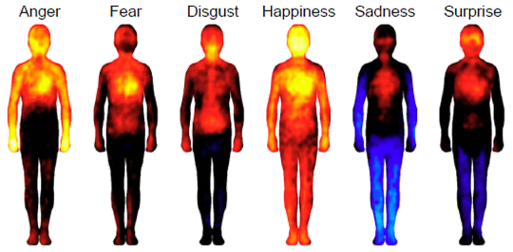
I Know How You Feel
Speech Emotion Recognition

Slide 2

Mohammed Buhliagah
MSC in Computer Science, 2013
Experience: Six years as information Technology Lecturer
GA: Data Science Immersive - Riyadh 2020
Project: AI Speech emotion recognition
Goal: Aiming to enable smarter business processes and implement analytics for meaningful insights.

Slide 3
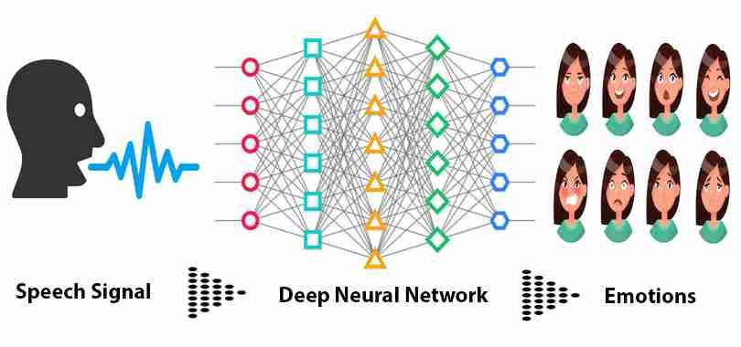
Notes:
Speech Signal Analysis Emotion

Slide 4
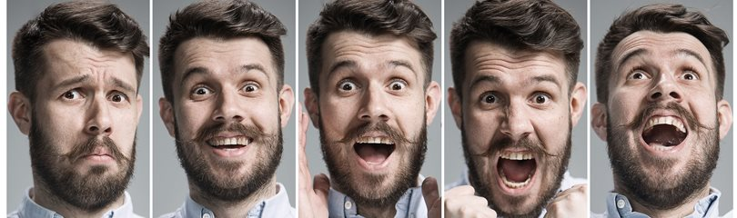
Notes:
https://www.factretriever.com/human-emotion-facts
Since we are different as human being we express emotions differently which results in misunderstanding
One of the challenges to knowing the other’s feeling is by their facial expressions and tone of voice. So, How Call Center or Customer experience know of their customer satisfaction

Slide 5
Call Center
Quality Effects
Speed
Time
Notes:
2- call center is the frontline of company operations, requiring ongoing, diligent monitoring. To effectively manage your customer experience, you need consistent tracking and measuring of metrics which are fundamental to determining agents and call center performance.
1- The success of any business depend on it customer experience and its involve many emotions
cycle SmartArt Speed (First Call Resolution)Time(Response Time) Quality Effects

Slide 6
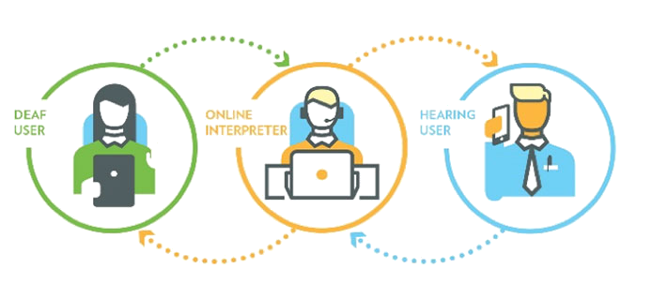

Phone Calls for Hearing Impaired
Notes:
https://depositphotos.com/11420684/stock-photo-woman-shouting-on-phone.html
https://www.istockphoto.com/photo/excited-young-woman-looking-at-her-mobile-phone-smiling-woman-reading-text-message-gm1060020740-283344305
Hearing impairment
Phone call for HI
Detecting Emotion
This is easy with people without any disability but with HI people detecting emotions be very challenging even with speech disorder
The HI can get their message with the emotion
Which make the communication human-like

Slide 7

Creating model to analysis speech signal then predict and classify speech sounds into emotions.

Slide 8

Datasets & EDA
Arabic Speech Emotion
Kaggel.com
Three Emotion
English Speech Emotion
RAVDESS
8 emotion
Labeled female and male
Notes:
The Ryerson Audio-Visual Database of Emotional Speech

Slide 9

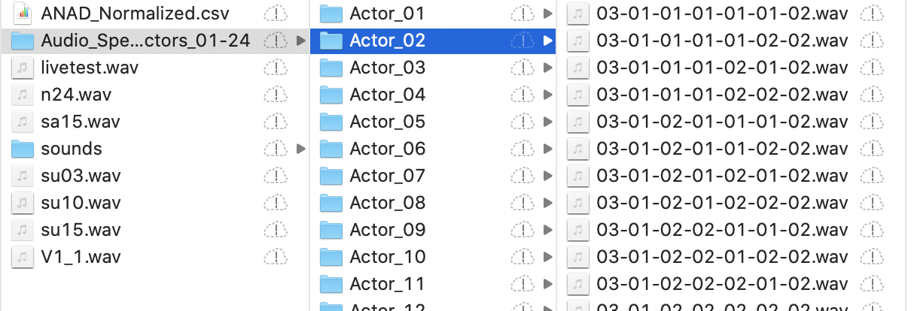
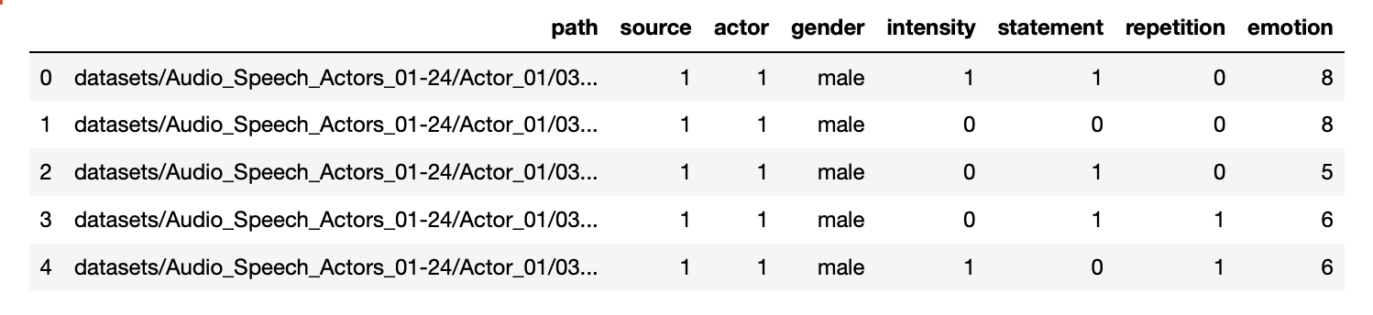
Reading Audio Data
"Kids are talking by the door"
"Dogs are sitting by the door"
Data length 1440
Notes:
https://zenodo.org/record/1188976

Slide 10
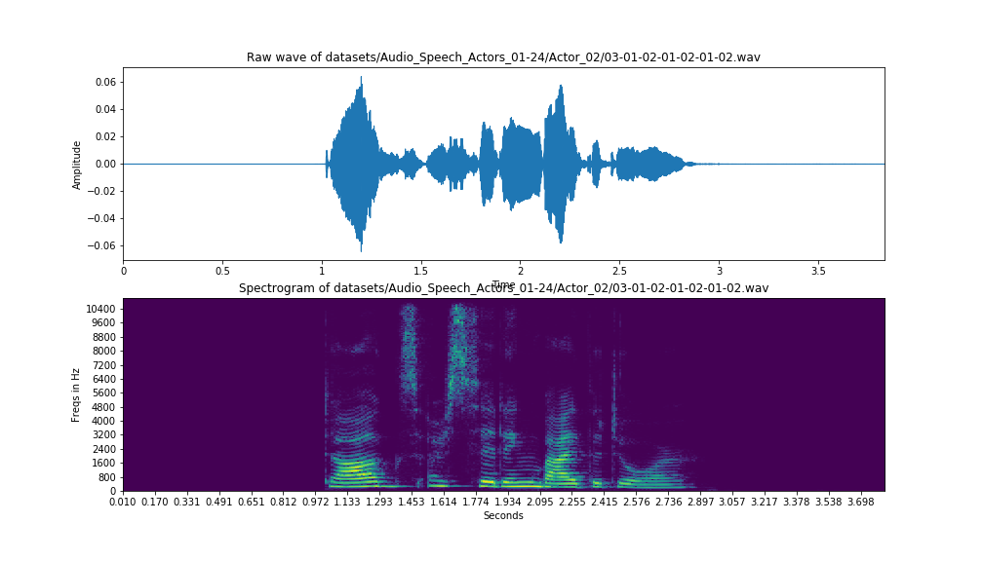
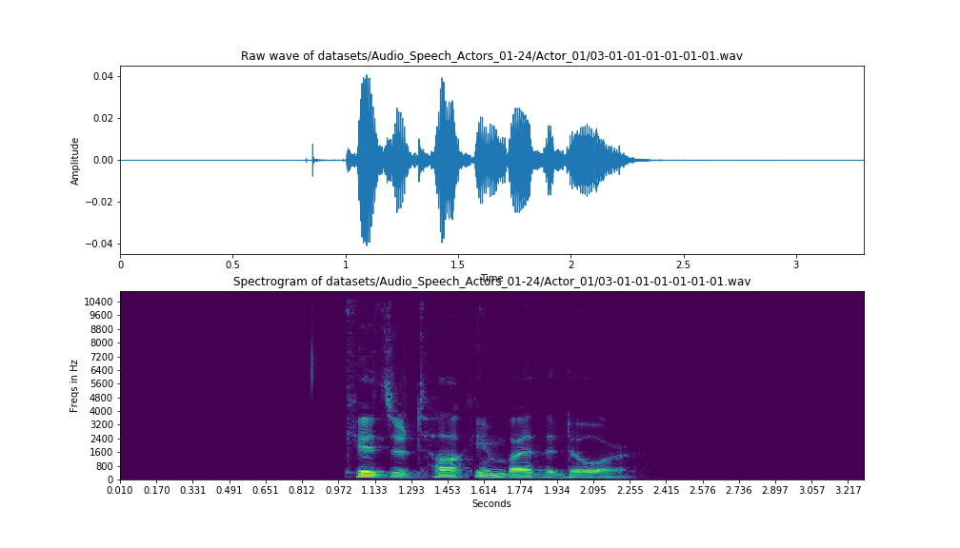
Emotion Spectrogram
Calm
Neutral

Slide 11
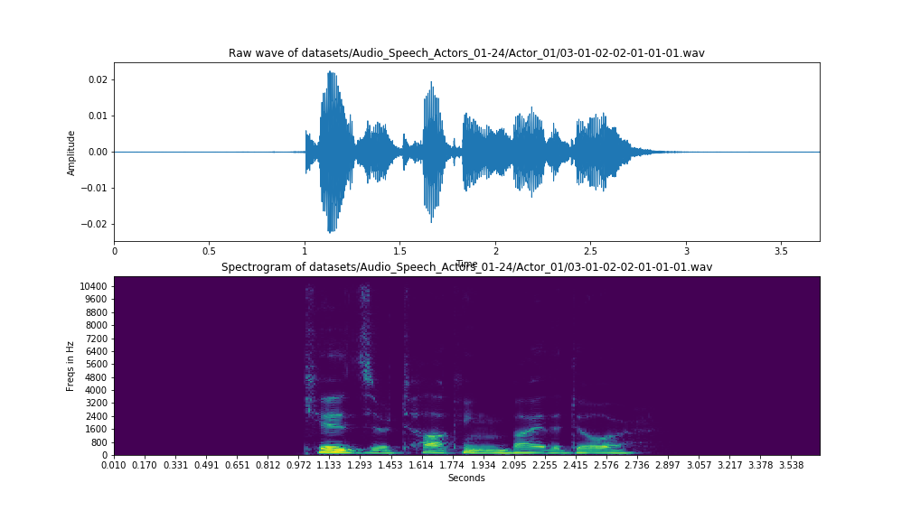
Emotion spectrogram
Female Calm
Male Calm

Slide 12
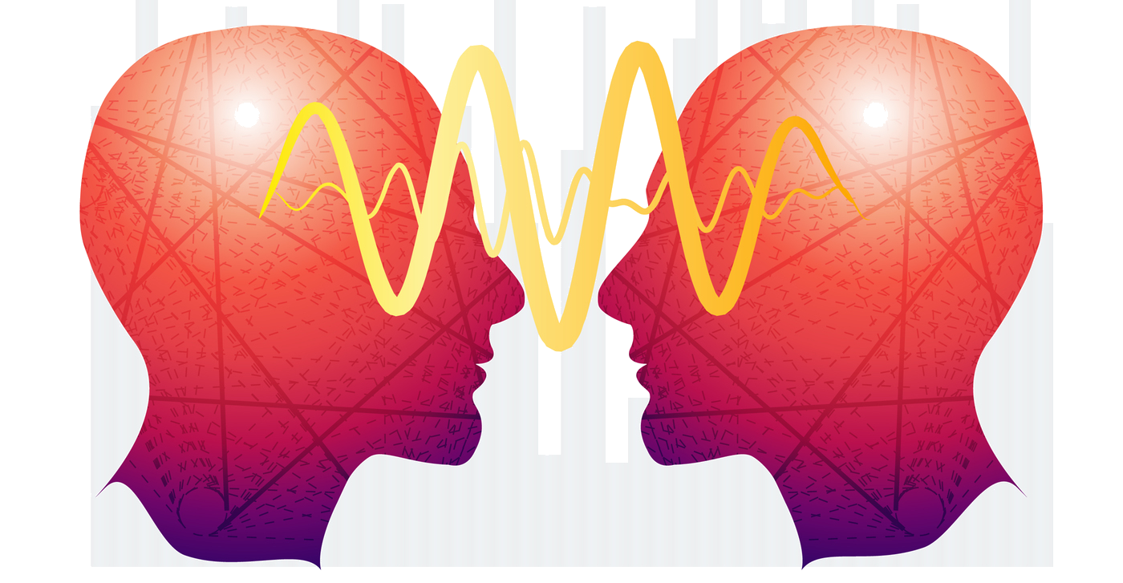
Key Findings
Building & Train CNN model to classify 8 emotion for two gender.
Data Augmentation:
Adding White Noise
Pitch Tuning.
Speed and Pitch Tuning.
Model:
Developed the CNN model with Keras and constructed with 6 layers — 5 Conv1D layers followed by a Dense layer.
Constructed with 3 Conv1D layers, 2 MaxPooling1D layer, 2 BarchNormalization, 1 dropout layer and followed by a Dense layer.
Constructed with 4 Conv1D layers, 2 MaxPooling1D layer, 2 BarchNormalization , 2 dropout and 2 Dense layers
Lastly constructed with 3 Conv1D layers with regularizers, 2 BarchNormalization, 4 MaxPooling1D, 4 dropout layers, and 3 Dense layers.
Adopting Reduce Learning On Plateau and save the best model with the min val loss only.

Slide 13
Key Findings
The best performance when applied both L2 regularization and dropout regularization.
Data Augmentation (Adding White Noise & Pitch Tuning.)
Base Score 7% | Train | Test
Accuracy | 97% | 83%
Loss | 49% | 99%

Slide 14
Key Findings
Experiment with different model
 | Test
MLPClassifier | 26%
SVM | 95%
KNN | 65%
Gradient Boosting | 78%

Slide 15
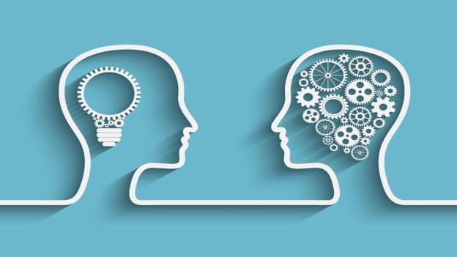
2nd Approach
Simplify the model by reducing the target class to:
{Sad, Happy, Fearful, Calm, Angry}
Developed the CNN model with Keras and Constructed with 8 Conv1D layers, 2 MaxPooling1D layer, 2 BarchNormalization, 2 dropout layer and followed by a Dense layer.
Base Score 10% | Train | Test
Accuracy | 99% | 92%
Loss | 3% | 31%

Slide 16
3rd Approach
Simplify the model to two model by reducing the target class to:
{ Gender} and { emotion only}
 | Gender |  | Emotion
 | Train | Test | Train | Test
Accuracy | 98% | 94% | 98% | 87%
Loss | 15% | 30% | 44% | 77%

Slide 17

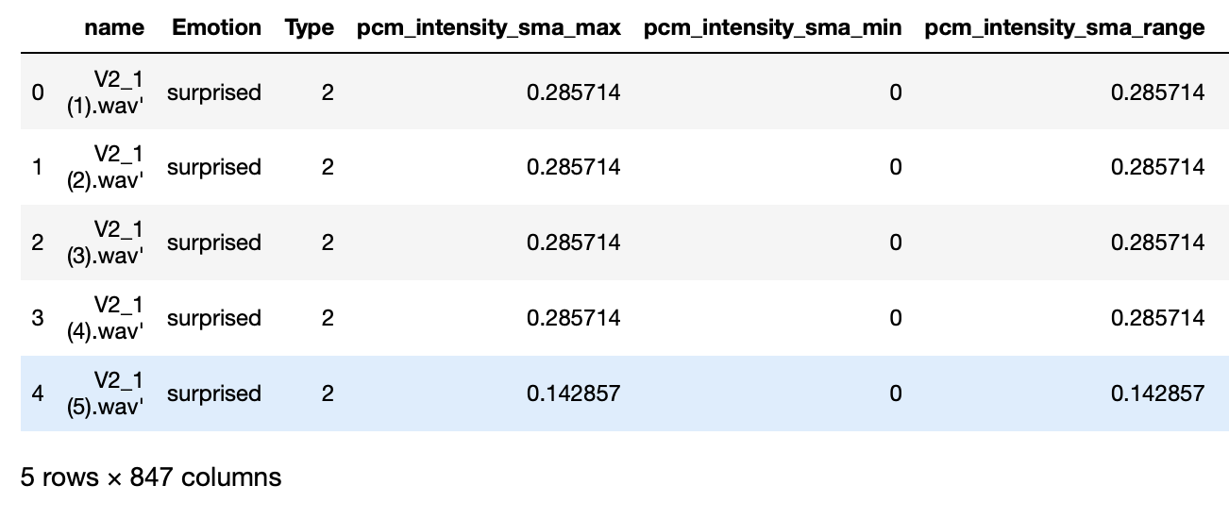
Arabic Audio Data
Data Shape (1383, 847)

Slide 18
Key Findings
Developed the CNN model with Keras and constructed with 3 Conv1D layers with regularizers, 2 BarchNormalization, 4 MaxPooling1D, 4 dropout layers, and 3 Dense layers.
Base Score 53% | Train | Test
Accuracy | 99% | 94%
Loss | 14% | 30%

Slide 19

Live Demo

Slide 20

Audio Data size
Arabic Sound lacking emotions and accuracy
Notes:
Google arabic corpus
Arabic Emotion XXXX

Slide 21

Action Points
Collecting more Audio data
Experiment with different augmentation method
Experiment with new model like RNN
Notes:
Talk about tools and recourses to improve the project
Making this project a tool for company and organizations to use like e-governments and Call center..etc
WHY
customer experience
No limit

Slide 22


What’s Next
Notes:
Talking about publishing the project
Making this project a tool for company and organizations to use like e-governments and Call center..etc
WHY/monitoring and improving customer experience will help business retain revenue and earn new customer.

Slide 23


Slide 24


